Slide 1

Inventory Management System

Slide 2

Problems in Managing Inventory

Slide 3

Problems in Managing Inventory
1. Manual Documentation

Slide 4

Problems in Managing Inventory
2. Inventory Loss

Slide 5

Problems in Managing Inventory
3. Inaccurate Data

Slide 6

Problems in Managing Inventory
4. Inefficient Processes

Slide 7

Solution For Effective Inventory Control
Become Digital

Slide 8
Benefits of Using This Program
Multiple user account can created.
Easy assess of Customer, Supplier, Product details.
Easy update, delete details of Customer, Product and Supplier.
No data duplicity.

Slide 9
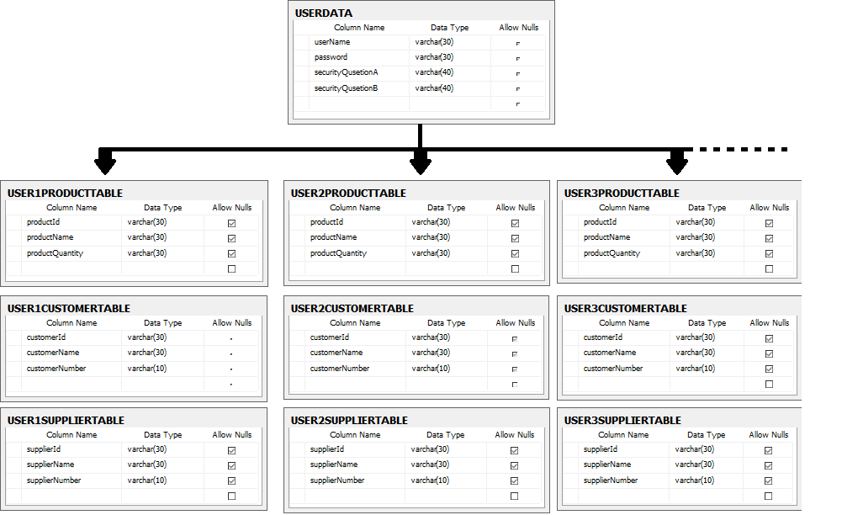
Database Structure of Program

Slide 10
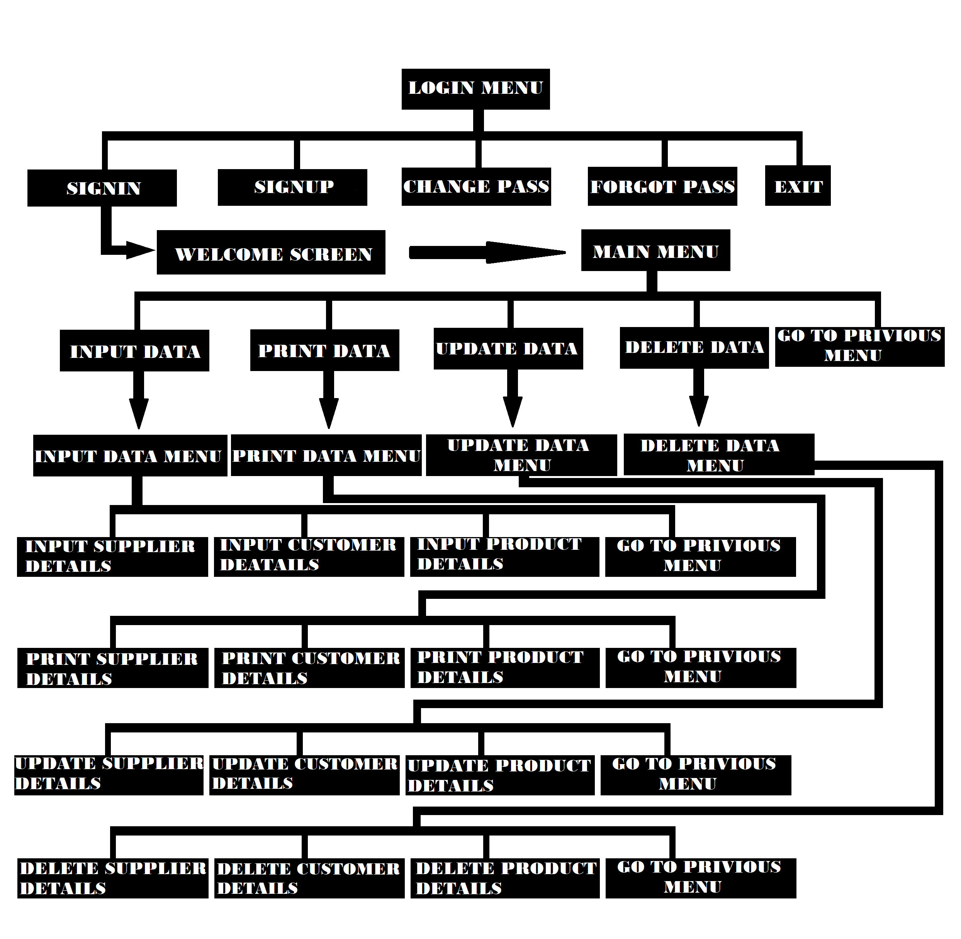
Program Menu Structure

Slide 11

Thank You

